Slide 1


Ridge and Lasso Regression
Session No.: 12
Course Name: Machine Learning
Course Code: R1UC525B
Instructor Name: Dr. Sivakumar Madeshwaran
Duration: 50 Minutes
Date of Conduction of Class: 16-09-2026

Slide 2

Recap of Previous Lecture
The Exponential Family includes a broad range of distributions, such as Normal, Poisson, and Bernoulli, which are useful for various statistical models.
Likelihood Estimation involves constructing a likelihood function to quantify how likely observed data is for different parameter values.
Maximum Likelihood Estimation (MLE) is a method that maximizes this likelihood function to estimate model parameters.
MLE has desirable properties like consistency, efficiency, and asymptotic unbiasedness, making it a preferred method in large samples.

Slide 3
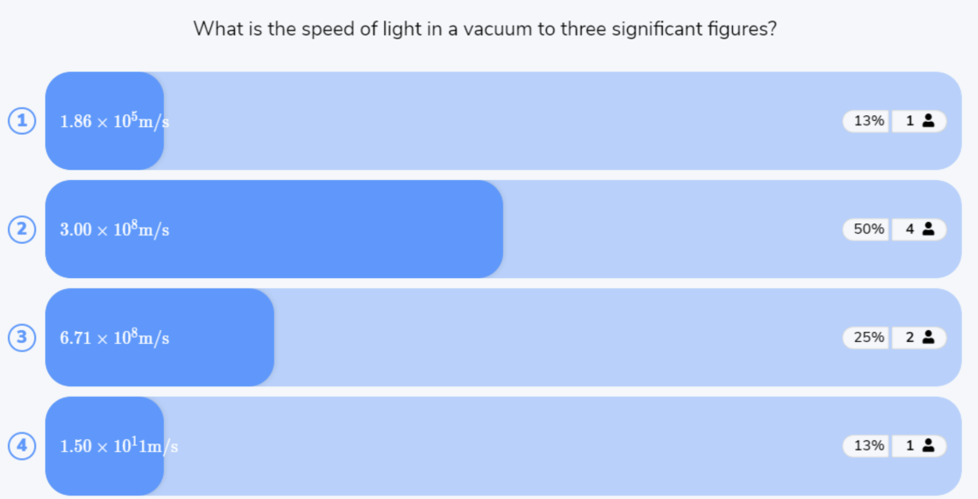
Reflect on the responses of post session activity

Slide 4

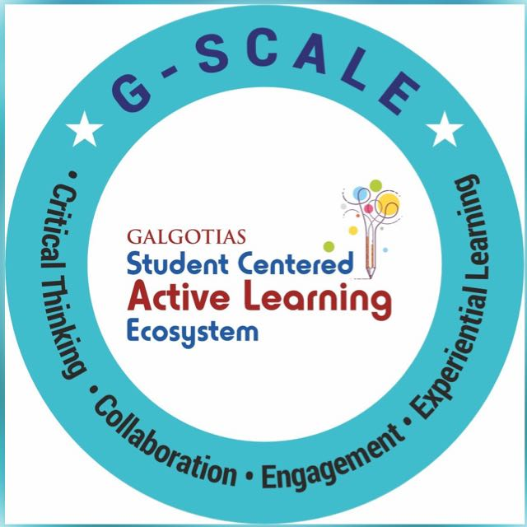


Why do we need Ridge and Lasso Regression when ordinary Linear Regression already predicts the output?
Opening Question

Slide 5
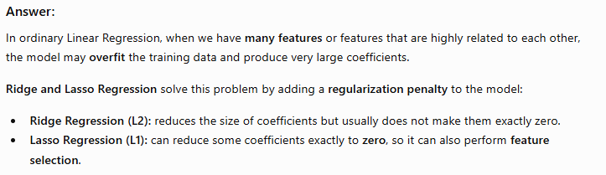
Opening Question -Reflections

Slide 6
At the end of this session students will be able to
LO1: Explain the concepts of Ridge and Lasso Regression, including regularization and their role in reducing overfitting.
LO2: Apply and compare Ridge and Lasso Regression models using regression coefficients

Slide 7
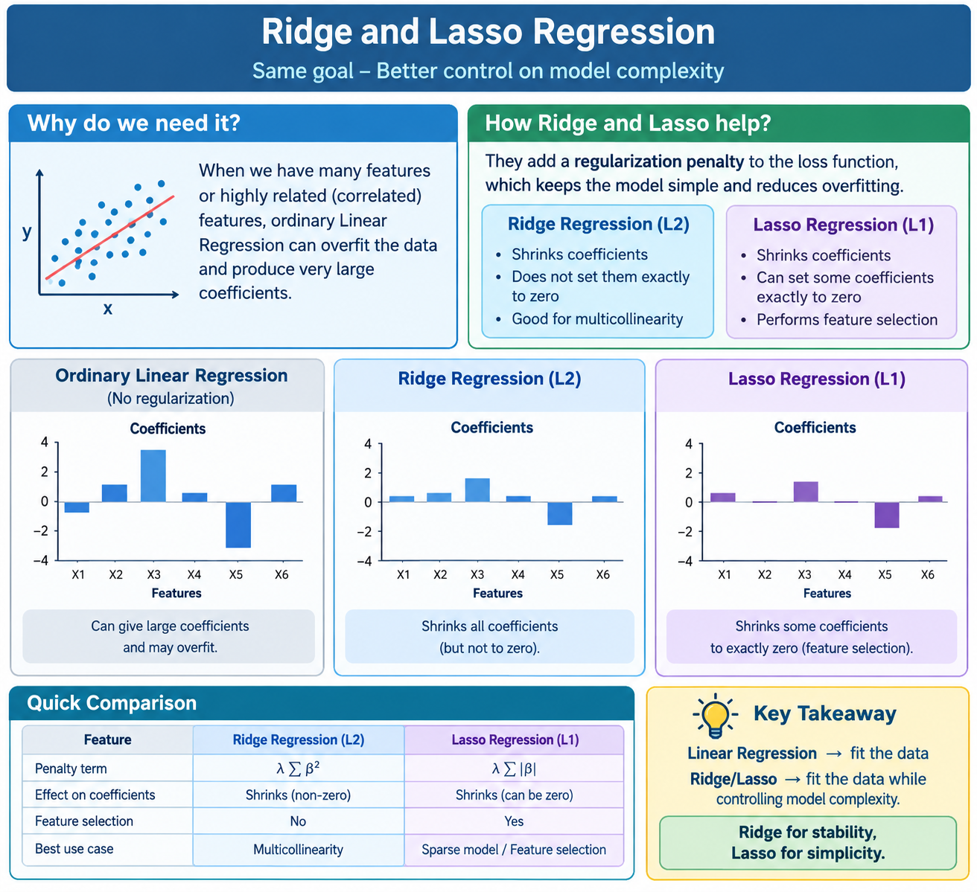
Ridge and Lasso Regression

Slide 8
Session Outline
1 Introduction
4 Activity-1 Problem Based Learning
6 Review and Reflections
2 Regularization
3 Lasso Regression
5 Ridge Regression

Slide 9
Regularization
Prevent Overfitting → Regularization adds a penalty on large coefficients, forcing the model to be simpler and reducing variance.
Handle Multicollinearity → Stabilizes coefficient estimates when predictors are highly correlated.
Improve Generalization → Makes the model perform better on unseen (test) data by controlling complexity.
Feature Selection (Lasso) → Automatically removes irrelevant features by shrinking their coefficients to zero.

Slide 10
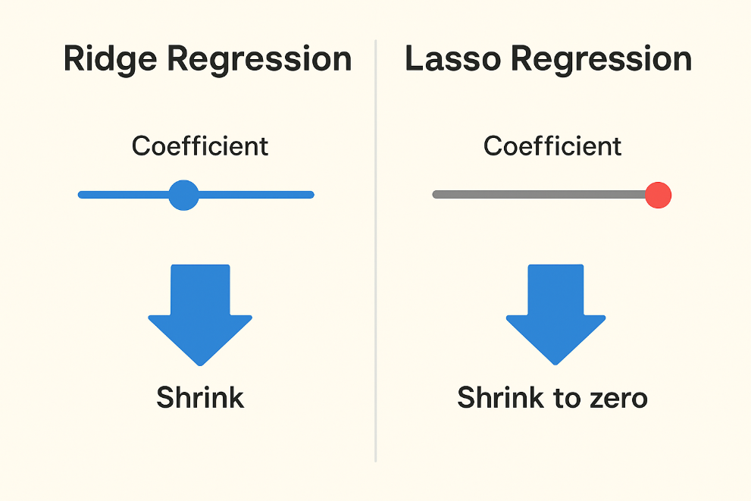
Lasso and Ridge Regression
Ridge Regression
Ridge makes all features smaller, but keeps every feature in the model.
Example: If you have 5 features, Ridge will use all 5 but reduce their effect.
Think: “Everyone stays, but they must speak softly.”
Lasso Regression
Lasso makes some features completely zero, removing them from the model.
Example: If you have 5 features, Lasso may decide only 2 are important → sets the other 3 to zero.
Think: “Only important people speak, the rest are silent.”

Slide 11
Example
Imagine a classroom:
You are a teacher trying to predict student marks based on:
📘 Hours studied
📅 Attendance
📝 Homework completed
🎮 Time spent on games
📱 Time on social media
Ridge Regression (L2)
Ridge says: “Every student (feature) can speak, but don’t speak too loudly.”
So, everyone contributes a little → no one is removed.
Even "games" and "social media" still get some weight, but very small.
Everyone stays in class, but talks quietly.
Lasso Regression (L1)
Lasso says: “Only the important students (features) get to speak. Others keep silent.”
It may completely silence "games" and "social media".
Result → only "hours studied" and "attendance" contribute.
Only useful students talk, others are silent (removed).
Ridge = keep all students, but control their voices.
Lasso = only let the best students speak, others silent.

Slide 12
Lasso Regression (L1 Regularization)
Lasso Regression is a method used in linear regression to improve the model by adding a penalty to the size of the coefficients.
It adds the sum of the absolute values of the coefficients (called the L1 penalty) to the loss function that the model tries to minimize.
This penalty encourages the model to shrink some of the coefficient values all the way to zero.
Lasso Regression = Linear Regression + Penalty.
The penalty is based on the absolute values of coefficients → this is called the L1 penalty.

Slide 13
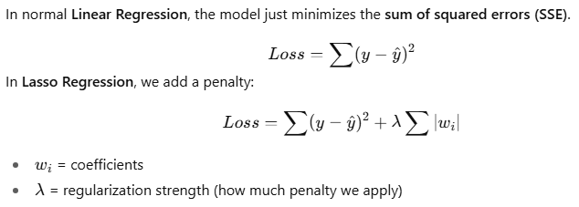
Lasso Regression Working
Ordinary Least Squares (OLS) Regression → Minimizes the sum of squared errors between predicted and actual values.
Penalty Term for Lasso Regression → Adds the sum of absolute values of coefficients (λ∑ ∣ β j ∣) to the loss function.
Shrinking Coefficients → Lasso reduces the size of coefficients, with some becoming exactly zero.
Selecting the optimal λ → Chosen using techniques like cross-validation to balance bias and variance.

Slide 14
When to use Lasso Regression
Feature Selection: It automatically selects most important features by reducing the coefficients of less significant features to zero.
Collinearity: When there is multicollinearity it can help us by reducing the coefficients of correlated variables and selecting only one of them.
Regularization: It helps preventing overfitting by penalizing large coefficients which is useful when the number of predictors is large.
Interpretability: Compared to traditional linear regression models that have all features lasso regression generates a model with fewer non-zero coefficients making model simpler to understand.

Slide 15
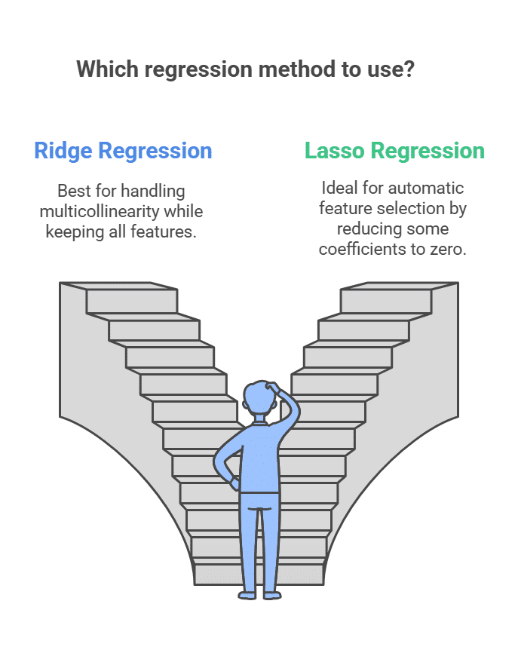
Lasso Regression
Advantages
Feature Selection
Regularization
Interpretability
Handles Large Feature Spaces

Slide 16
Learning Activity 1
Problem-Based Learning
Activity Title: Model Overfitting in a Real Dataset
Task: Students are given a real-world dataset (e.g., housing prices or medical data) where the number of features is large.
Problem Statement: "Your linear model is overfitting. How would you modify your regression approach using regularization?"
Goal: Students work in small groups to:
  Identify Ridge and Lasso as potential solutions.
  Discuss which one fits better depending on the scenario (e.g., many correlated features vs. sparse features).
  Justify their choice based on model performance.

Slide 17
Ridge Regression (L2 Regularization)
Ridge Regression is a type of linear regression that adds a penalty based on the square of the size of the coefficients to the loss function.
It reduces overfitting by shrinking coefficients, but unlike Lasso, it never makes them exactly zero.
It helps prevent overfitting by keeping the model simpler and more stable.

Slide 18
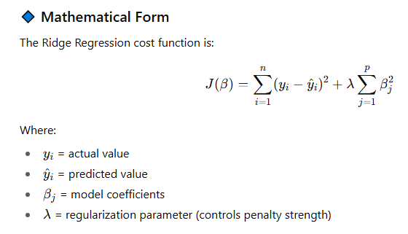
Ridge Regression (L2 Regularization)

Slide 19
Ridge Regression (L2 Regularization)
Selection of the Ridge Parameter in Ridge Regression
Cross-Validation → Splits data into training and validation sets multiple times to estimate model performance reliably.
Generalized Cross-Validation (GCV) → A computationally efficient form of cross-validation using a formula instead of explicit data splitting.
Information Criteria → Model selection methods that balance goodness of fit with model complexity.
Empirical Bayes Methods → Estimate prior distributions directly from the data to improve regularization.
Stability Selection → Combines subsampling with variable selection to identify features that consistently appear important.

Slide 20

Ridge Regression
Advantages
Stability
Bias-Variance Tradeoff
Interpretability
Disadvantages
Bias Introduction
Parameter Selection
Not Suitable for Variable Selection
Applications of Ridge Regression
Forecasting Economic Indicators
Medical Diagnosis
Sales Prediction
Risk Management

Slide 21
Ridge Regression (L2 Regularization)
Feature | Ridge (L2) | Lasso (L1)
Penalty | Squares of coefficients | Absolute values of coefficients
Coefficient Shrinkage | Small but nonzero | Some become exactly zero
Feature Selection | ❌ No | ✅ Yes
Best Case | Many small/medium effects | Few strong effects

Slide 22
Summary
Ridge and Lasso are regularization techniques to prevent overfitting in regression models.
Lasso (L1) shrinks coefficients and can set some to zero, performing feature selection.
Ridge (L2) shrinks coefficients but keeps all features, useful for multicollinearity.
Lasso: Feature selection + regularization.
Ridge: Regularization only, keeps all variables.
Both improve model generalization and reduce overfitting.

Slide 23
Ensure attainment of LOs in alignment to the learning activities: outcomes (1-2)
LO1: Explain the concepts of Ridge and Lasso Regression, including regularization and their role in reducing overfitting.
LO2: Apply and compare Ridge and Lasso Regression models using regression coefficients

Slide 24

Post Session Activity

Slide 25
Information about the next lesson
Naive Bayes

Slide 26


Review and Reflection from students

